Slide 1
Trainity Project 3
Operation Analytics and Investigating Metric Spike
Chetan Vishwakarma

Slide 2
Brief overview of the project
Two different datasets are provided. Job_data and users,email,email_events data
Job_data database is having only 9 -10 rows of data , hence need to create dummy data for analysis.
Dataset-2 has 3 csv files which need to be imported in the sql environment so the analysis.
Our role is to import and analyze the data and retrieve important insights through the tables present in the database which could be used for the betterment of the business and to obtain the trends present if any in the data for analysis of the future hike or fall.
For the retrieval of data, we are going to use SQL workbench because of the following reasons:
It allows you to obtain results very quickly.
Codes can be optimized to obtain results quickly.
Data integrity is ensured.
It can analyze multiple tables at once.

Slide 3
Case study 1: Job Data analysis
Jobs Reviewed Over Time:
Objective: Calculate the number of jobs reviewed per hour for each day in November 2020.
Your Task: Write an SQL query to calculate the number of jobs reviewed per hour for each day in November 2020.
Approach: Firstly table was studied carefully and the table which could be used for the retrieval of the data was chosen i.e job_data table
Since time spent for each day in November was required, hence, firstly sum of time spent was done and the group by function was on date column and actor_id column. Since the jobs reviewed time was in seconds and the output required should be in hours, Hence dividing the value by 3600 so that it gets converted into hours

Slide 4
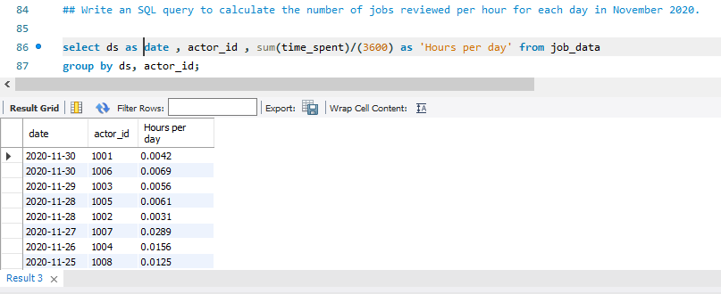
Code and Output of the code :

Slide 5
Throughput Analysis:
Objective: Calculate the 7-day rolling average of throughput (number of events per second).
Your Task: Write an SQL query to calculate the 7-day rolling average of throughput. Additionally, explain whether you prefer using the daily metric or the 7-day rolling average for throughput, and why.
Approach: For 7-day rolling average, average of time spent was used with respect to over partition function .In the function , 6 preceding and one current row was used which will give a 7 day average.
Then, order by function was used on date function so that we get a clear indication on the calculation
We used mainly prefer 7 day rolling average because, it gives a weekly trend while plotting the graph and the graph also remains clear to understand in weekly basis than daily metric.because daily metric points graph remaining very detailed can confuse the person studying it.

Slide 6
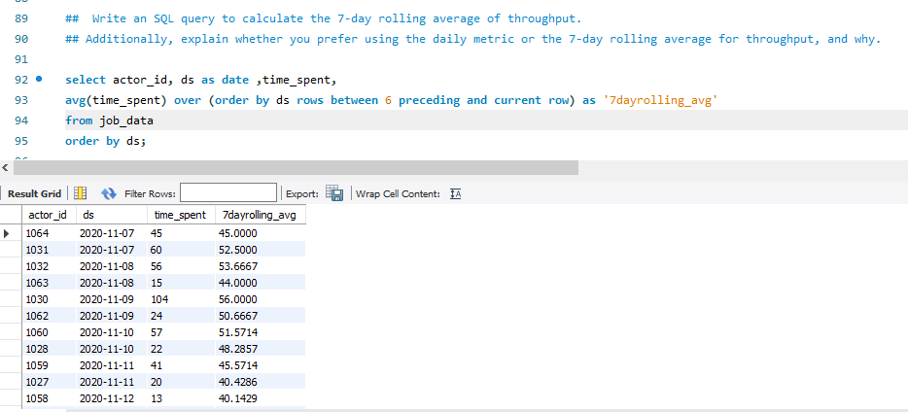
Code and Output of the code :

Slide 7
Language Share Analysis:
Objective: Calculate the percentage share of each language in the last 30 days.
Your Task: Write an SQL query to calculate the percentage share of each language over the last 30 days.
Approach: For calculating the percentage share each language over last 30 days, firstly a view named total_time was created which included the total time spent for all the languages.
Then this view was used to calculate the percentage where sum of time spend with respect to each language was done using group by function and divided by the total time.

Slide 8
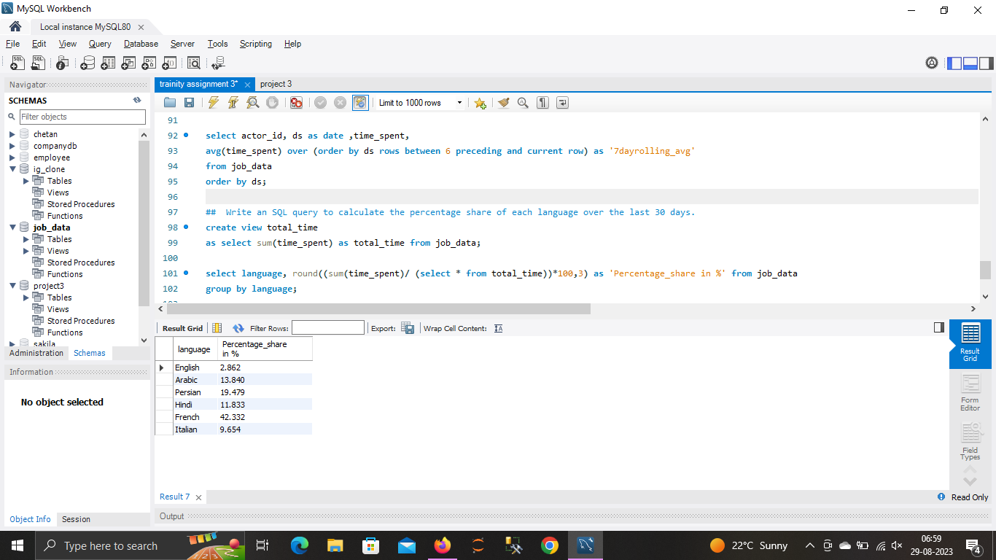
Code and Output of the code :

Slide 9
Duplicate Rows Detection:
Objective: Identify duplicate rows in the data.
Your Task: Write an SQL query to display duplicate rows from the job_data table.
Approach : To obtain the duplicate values, we needed to find the rows which had all values same for each column. For this group by function was used on all columns and checked using where clause whether there is any column which had count more than one.
Since i had no duplicate columns hence the the output was empty

Slide 10
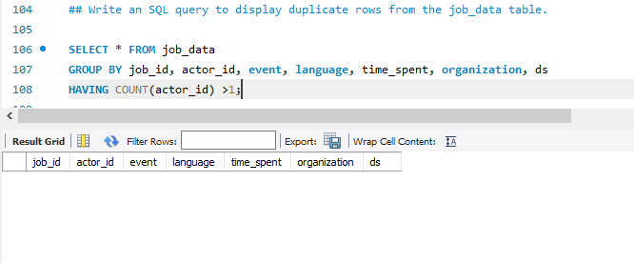
Code and Output of the code :

Slide 11
Case Study 2: Investigating Metric Spike
Weekly User Engagement:
Objective: Measure the activeness of users on a weekly basis.
Your Task: Write an SQL query to calculate the weekly user engagement.
Approach :To calculate the weekly user engagement, we extract week from the date column and then use count function on user_id with respect to week_no using group by and order by function.
Total 19 records were obtained.

Slide 12
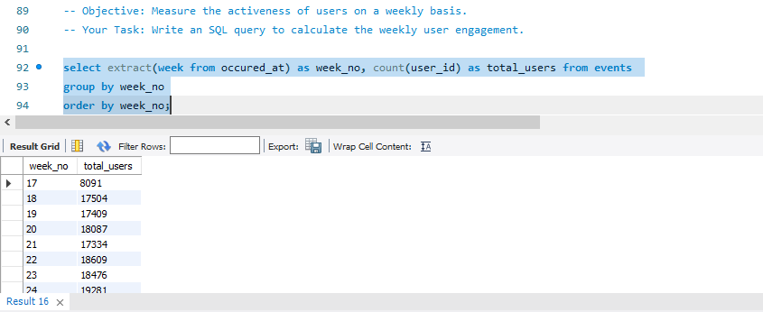
Code and Output of the code :

Slide 13
User Growth Analysis:
Objective: Analyze the growth of users over time for a product.
Your Task: Write an SQL query to calculate the user growth for the product.
Approach : Firstly extracted year value and month value using extract function. Since, we wanted to obtain the growth of users for a product hence used over function in sum of user_id
And mainly growth could be obtained by cumulative addition of each rows hence done unbounded preceding and current rows so that it could take the addition of all rows one by one in the column and where clause is used in the condition of state = active
Total 89 records were obtained.
At the end we have the total amount of active users ie.9381 users.

Slide 14
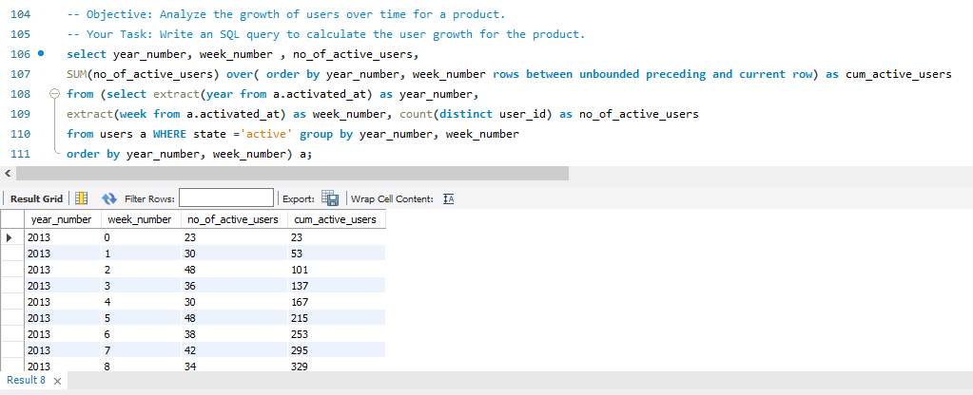

Code and Output of the code :

Slide 15
Weekly Retention Analysis:
Objective: Analyze the retention of users on a weekly basis after signing up for a product.
Your Task: Write an SQL query to calculate the weekly retention of users based on their sign-up cohort.
Approach : Firstly, we will extract the week from occured_at column , then we sort out those rows which have evet_type = signup_flow and event_name = complete_signup. Then we use left join function to join the two tables on the basis of user_id where event_type = engagement.
Since we want the data with respect to user_id hence we use gropu_by and order_by function on user_id column.
Total 163 records were obtained.

Slide 16
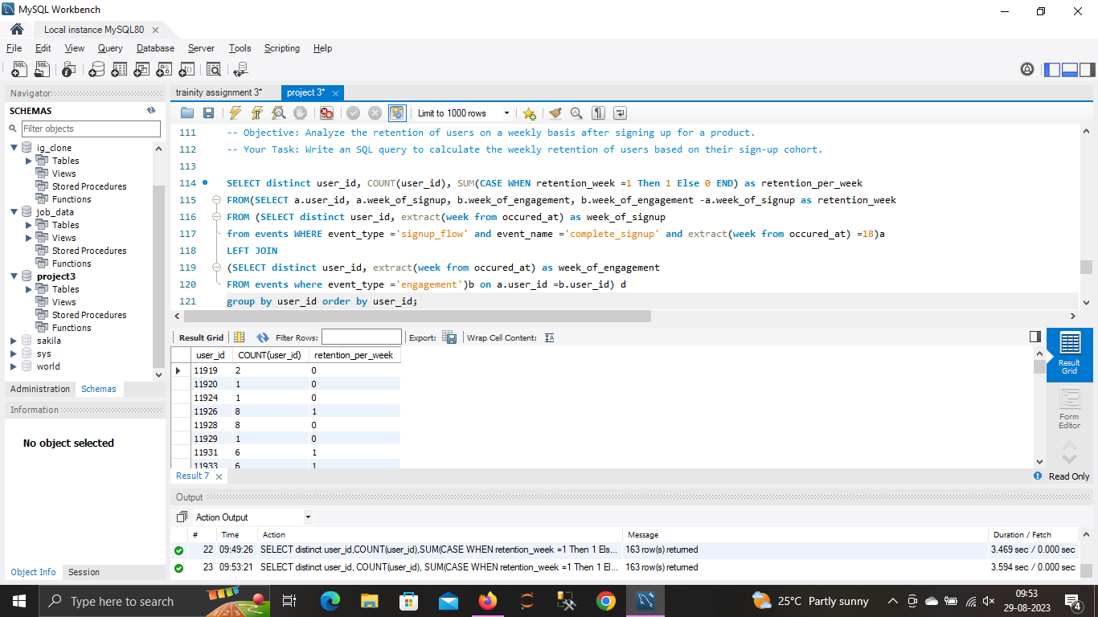
Code and Output of the code :

Slide 17
Weekly Engagement Per Device:
Objective: Measure the activeness of users on a weekly basis per device.
Your Task: Write an SQL query to calculate the weekly engagement per device.
Approach : To calculate the weekly engagement per device on weekly basis, we firstly extract the year value and no of month separately.
Then count of user_id is done with respect to no_of_year, no_of_month and device using group by function and then use order by function on the same columns.
Total 491 records were obtained.

Slide 18
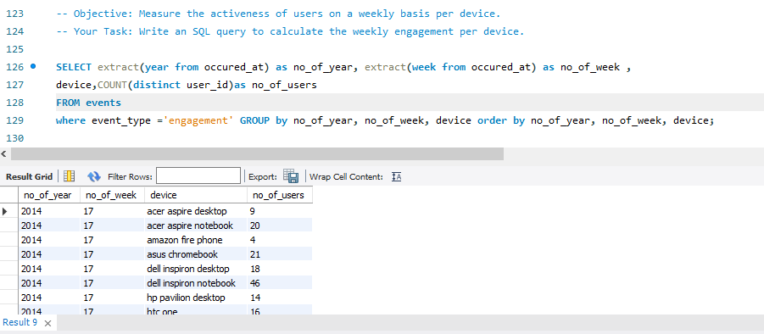
Code and Output of the code :

Slide 19
Email Engagement Analysis:
Objective: Analyze how users are engaging with the email service.
Your Task: Write an SQL query to calculate the email engagement metrics.
Approach : firstly we categorize the 4 unique values of action column of email_events into 3 i.e we club sent_weekly_digest , sent_reengagement_email to email_sent and other both remaining the same.
To calculate the email engagement metrics, we first create a case in which we divide category by email_opened to email_sent which will be the email_opening_rate.
In the second case, we divide the category email_clicked to email_sent which will be the email_clicking_rate

Slide 20
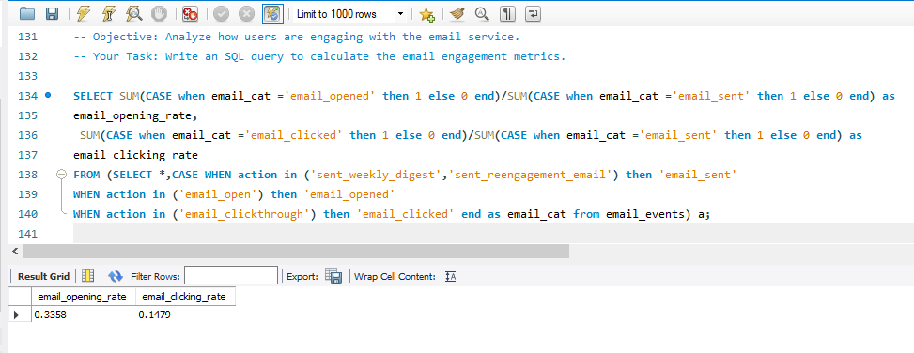
Code and Output of the code :

Slide 21
Result :
Through this project, got the clear knowledge to how to import csv files into sql environment and then change the string column to datetime.
Got a knowledge of how data is present in real-life world.
Got to practice more on over partition function and other functions like Groupby and orderby with over_partition and join
Got a clear understanding on how to join multiple tables and use it with over() partition
Got to practice about views and case functions also.
Because of the project, feeling pretty confident now to use SQL workbench.

